Slide 1


Pyshark
CNIT 48101

Slide 2
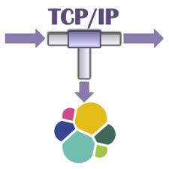
Pyshark Intro
Python wrapper for Wireshark
Uses t-shark as a dependency
https://kiminewt.github.io/pyshark/
Uses:
Automated packet capture sessions
Automatically sending packet data to different applications
Logging
Packet analysis
Automated Reporting

Slide 3

Advantages
Simple and easy to use
Uses the familiar t-shark (Wireshark)
Comes with t-shark exclusive functionality (tcp stream indexing)

Slide 4
Disadvantages
Limited functionality
doesn’t contain all the features of t-shark
limited by what t-shark allows
Documentation on advanced features is lacking
Not guaranteed to be maintained
Owned by one private GitHub user: Kiminewt
Screenshot from t-shark Github page

Slide 5
Getting Started
Install pyshark. Use pip or pip3 depending on your Python setup.
pip install pyshark
Import the pyshark module.
import pyshark
for more info: https://github.com/KimiNewt/pyshark

Slide 6
Capture types
Pyshark has four ways of reading (capturing) packets
Live
File
Remote
InMem
Ring Capture
Please refer to the capture file comments for documentation:
https://github.com/KimiNewt/pyshark/tree/master/src/pyshark/capture

Slide 7
General Capture Parameters
These parameters are shared by all capture types:
<str> display_filter: filter what packets are displayed from the capture
<bool> use_json: Use t-shark in JSON mode. Needs Wireshark >= 2.2. Defaults to false.
<bool> include_raw: include raw packet data. Default false. use_json must also be set to true use this option.
<bool> only_summaries: Only captures summaries but speeds up captures
<str> decryption_key: the decryption key if the traffic you are capturing is encrypted

Slide 8
General Capture Parameters (Cont.)
<str> encryption_type: the encryption type. must be either 'WEP','WPA-PWD', or 'WPA-PWK'. Defaults to 'WPA-PWK'
<dict> decode_as: You can assign protocols to certain packet behavior that's not usually standard. (e.g. {‘tcp.port == 888’: ‘http’})
<dict> override_prefs: Allows you to override t-shark default run preferences
<str> disable_protocol: tells t-shark to stop scanning for a certain protocol
<str> tshark_path: path to t-shark binary
<str> bpf_filter: Berkley Packet Filter to filter capture

Slide 9
Berkley Packet Filter (BPF)
All of the captures can be filtered using the Berkley Packet Filter (BPF) standard:
Standardized syntax for packet filtering
Standard across several networking applications
Example:
Only displays tcp packets whose destination is port 80
tcp port 80
For more info visit: http://biot.com/capstats/bpf.html

Slide 10
Wireshark Filter
Pyshark also allows you to filter packets using the Wireshark filtering syntax.
see display_filter and capture_filter
Allows you to filter on Wireshark specific properties (e.g. tcp stream indexes)
Example:
tcp and ip.dst == 80
For more info: https://wiki.wireshark.org/DisplayFilters

Slide 11
Live Capture
Regular Wireshark capture. Captures from a live interface
capture = pyshark.LiveCapture(interface=‘<interface>’)
Required params:
<str> interface: The interface to capture on.
Optional Params:
<str> output_file: you can specify a file to write captured files to

Slide 12
Live Ring Capture
Allows you to capture using a ring buffer.
capture = pyshark.LiveRingCapture(interface=‘<interface>’)
Required Params
<str> interface: interface to capture on.

Slide 13
Live Ring Capture (Cont.)
Optional Params
<int> ring_file_size: Size of each ring file.
Defaults to 1024
<int> num_ring_files: number of rings files to use.
Defaults to 1
<str / str array> ring_file_name: file path of ring files. Defaults /tmp/pyshark.pcap
more info: https://www.wireshark.org/docs/wsug_html_chunked/ChCapCaptureFiles.html

Slide 14
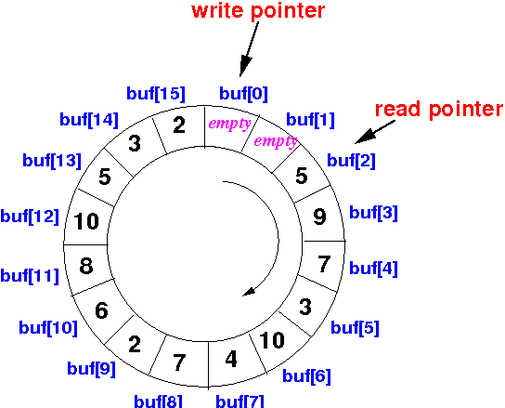
Ring Buffers
A ring buffer is a data structure that overwrites the oldest part of the buffer when it fills thus forming a ring.
In our case, we have a buffer of pcap files that packets will be written to
When the last file fills up, the oldest file written to will be overwritten with new data
These file form our “ring”

Slide 15
File Capture
Read from pcap file
capture = pyshark.FileCapture(input_file=‘<inputFile>’)
Required params:
<str> input_file: The interface to capture on.
Optional Params:
<str> output_file: you can specify a file to write read files to
<bool> keep_packets: keep packets after reading

Slide 16
Remote Capture
Allows you to capture packets on a remote machine running rdcapd.
capture = pyshark.RemoteCapture(remote_host = ‘<host>’, remote_interface= ‘<interface’>, remote_port = ‘<port>’)
Required Params
<str> remote_host: IP or hostname of remote host
<str> remote_interface: The remote interface to capture on. On Windows, use the true device name instead of the display name
<str> remote_port: the port rdcapd is listening on

Slide 17
InMem Capture
For reading binary/raw packet data
capture = pyshark.InMemCapture(linktype=‘<LinkType>’)
Required params:
<LinkType Object> link_type: Type of packet being sent

Slide 18

The Capture Class
If you’ve noticed, we have been assigning all our captures to a variable capture.
That is because each one of the capture functions creates a capture object. This object has several functions available to it.

Slide 19
sniff()
For LiveCapture, LiveRingCapture and RemoteCapture, you must call the sniff() function to actually start capturing data
capture.sniff(timeout = <timeout>, packet_count = <count>)
Optional Params
<int> timeout = Will stop capturing packets after a specified amount of time.
<int> packet_count = Will stop after a certain amount of packets captured.

Slide 20
sniff() example
capture.sniff(packet_count = 100)
#Will execute after sniff() is finished:
for packet in capture:
print(packet)

Slide 21
sniff_continously
Alternatively, if you want to process packets as they come in, use sniff_continously().
capture.sniff_continously(timeout = <timeout>, packet_count = <count>)
Optional Params
<int> timeout = Will stop capturing packets after a specified amount of time.
<int> packet_count = Will stop after a certain amount of packets captured.
Note: This function is not available for LiveRingCapture()

Slide 22
sniff_continously Example
for packet in capture.sniff_continously(packet_count = 10):
print(“packet just came in ”, packet)

Slide 23
load_packets()
Loads packets into the capture object. Like sniff() but works for all capture types
capture.load_packets(timeout = <timeout>, packet_count = <count>)
Optional Params
<int> timeout = Will stop capturing packets after a specified amount of time.
<int> packet_count = Will stop after a certain amount of packets loaded.

Slide 24
Capture class functions
Clears all the packets from the capture object
capture.clear()
Resets the capture object to read from the beginning
capture.reset()
Selects the next packets
capture.next_packet()

Slide 25
Capture class functions
Allow you to run a function on all packets
capture.apply_on_packet()
Gets parameters that tshark is running with
capture.get_parameters()

Slide 26
Iterating Through Packets
Packets in a capture can be accessed by iterating through the capture object in a loop.
capture = pyshark.FileCapture(input_file=‘file.pcap’)
for packet in capture:
print(packet)

Slide 27
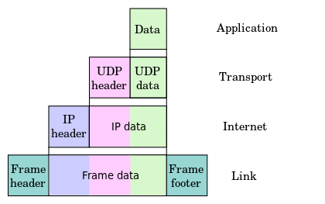
The Packet Object
Packets are represented as Python dictionaries. Each layer of the IP packet is also a dictionary within the packet dictionary. Packet fields such as timestamps are fields in the corresponding sub-dictionary.

Slide 28
Accessing Packet Data
Data in the packet can be accessed using the following syntax:
for packet in capture:
packet.tcp.src_ip
or
packet[‘tcp’][‘src_ip’]

Slide 29
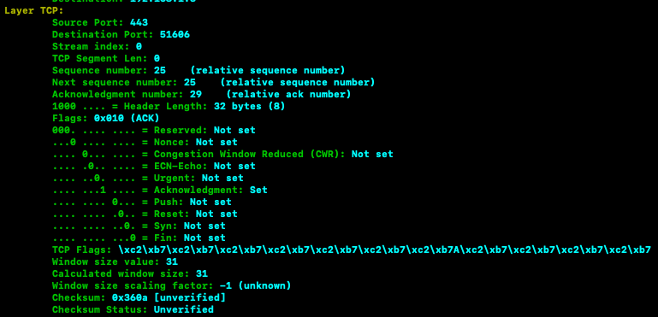
Printing Packet Data
You can use Python’s inbuilt print() or pprint() functions but it is suggested you use pyshark’s .pretty_print() function instead.
packet.pretty_print()

Slide 30
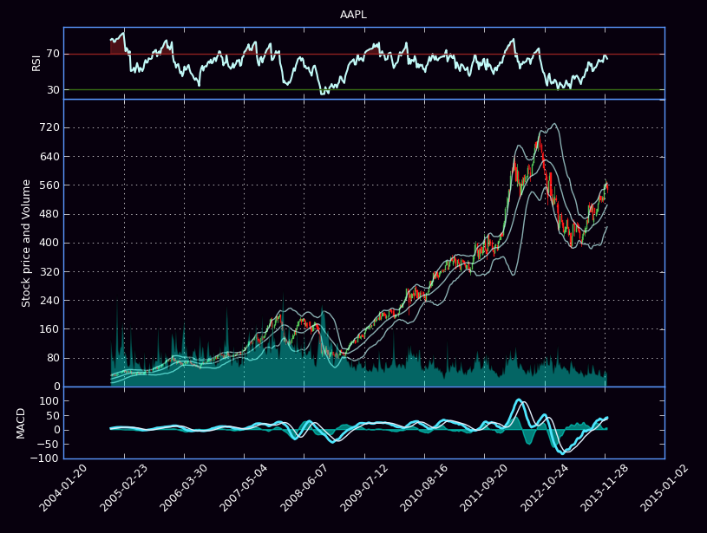
Visualizing Packet Data
You may want to visualize the data from your capture.
Unfortunately, pyshark doesn’t come with any inbuilt visualization functions. Luckily, you can use any of Python’s many graphing libraries. Some popular ones are:
Matplotlib: https://matplotlib.org/
Pygal: http://pygal.org/en/stable/
ggplot: https://ggplot2.tidyverse.org/reference/ggplot.html

